Slide 1


BANA6043 Group 6 Final Group Presentation ​
Created by:​
Nanditha Ganesh
Lakshman Duggirala​
Ritu Shankar
Sriram Ganeshraj

Slide 2
PROBLEM STATEMENT
Our Sudden Cardiac Arrest data highlights a significant analysis and provides key insights into the early detection of cardiac arrest.
The CEO should be interested in this issue as it focuses on tackling the challenge of early detection of cardiac arrest risk in individuals by analyzing past patient data from Heart-Well Wellness Center. The aim is to identify crucial risk indicators and patterns that could aid in preemptively pinpointing patients at increased risk. Our objective is to leverage this data analysis to improve patient care and outcomes.

Slide 3
Data used and the analytic methodology employed
Conducted an initial Exploratory Data Analysis (EDA) to assess the analysis of data characteristics such as distribution, correlation, and missing values.
Used techniques like K-nearest neighbor and random forest classifier for model building.
Performed model evaluation and comparison using cross-validation performance metrics.

Slide 4
Data Findings and analysis
Our findings provided a detailed look at summary statistics, showcasing key metrics like average age, blood pressure, cholesterol levels, and their distributions within the dataset.
Found that there are no null values in these columns and opted to include outliers in our analysis.
These methodologies and findings provided valuable insights into the risk factors and predictive indicators for cardiac arrest, contributing to better patient risk assessment and healthcare strategies.

Slide 5
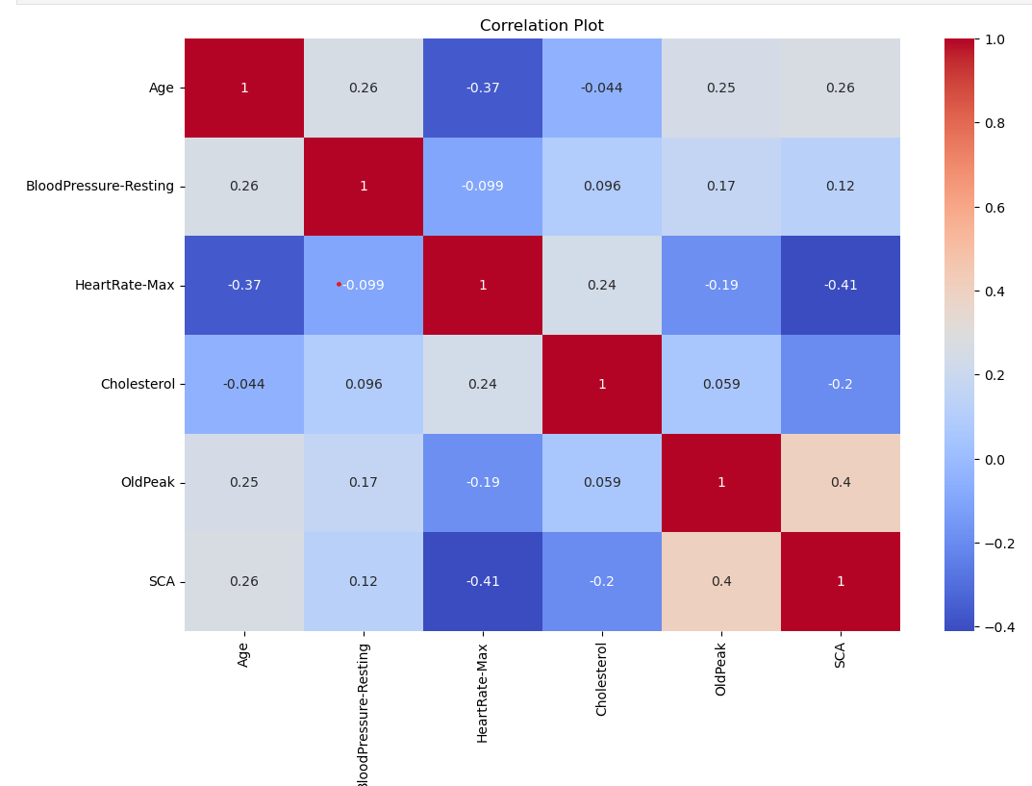
FINDINGS
The plot illustrates the degree of correlation among various variables. Specifically, it points us to focus more closely on Age, Heart rate, and Cholesterol, as these are the variables of particular interest in understanding their relationships.

Slide 6
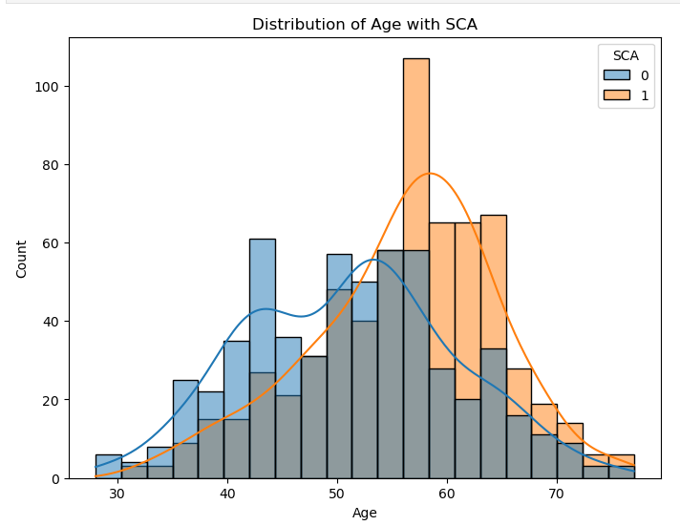
FINDINGS
The distribution analysis of Age about Sudden Cardiac Arrest (SCA) reveals that the likelihood of SCA is higher in older patients, particularly those aged from their mid-50s to late-70s.

Slide 7
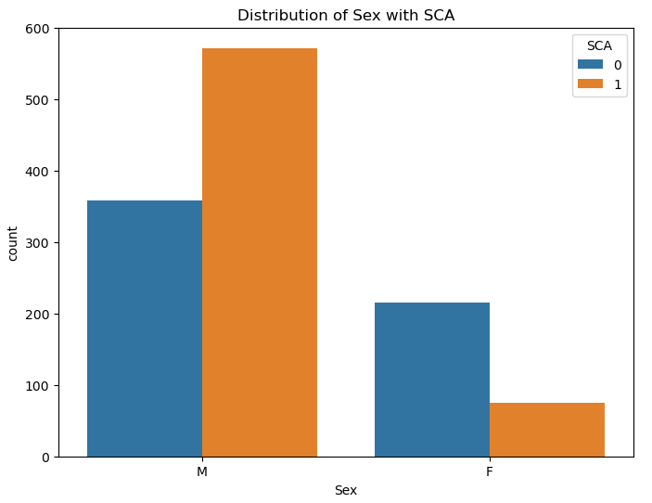
FINDINGS
The plot suggests that men are at a higher risk of experiencing sudden cardiac arrest compared to women, with the incidence in men significantly exceeding that in women, where the numbers are notably smaller, less than 100.

Slide 8

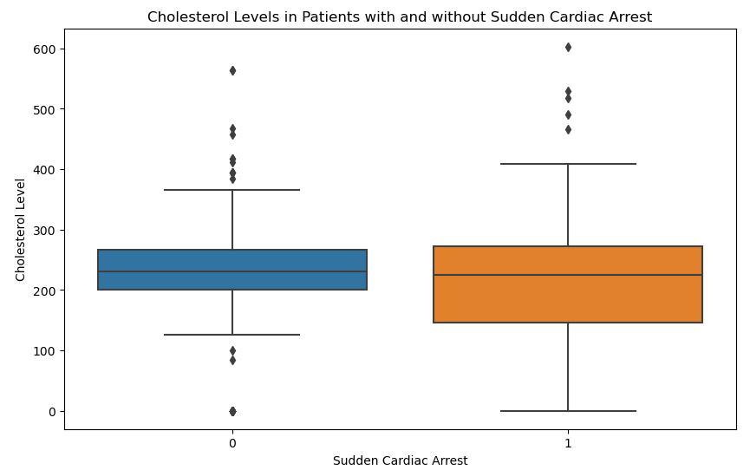
FINDINGS
The analysis of cholesterol levels in patients with Sudden Cardiac Arrest (SCA) indicates that both the Interquartile Range (IQR) and the total range of cholesterol levels in these patients span from 0 to 400.

Slide 9

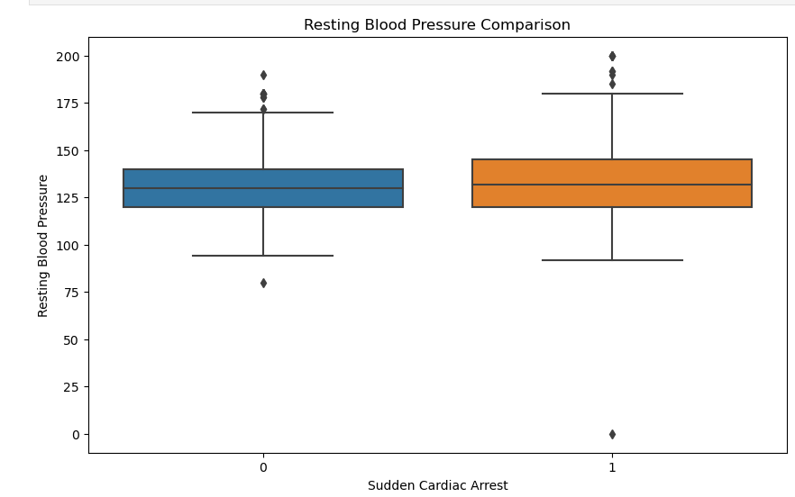
FINDINGS
The boxplot presented visualizes the relationship between blood pressure and the occurrence of Sudden Cardiac Arrest (SCA), comparing patients with SCA against those without it.

Slide 10

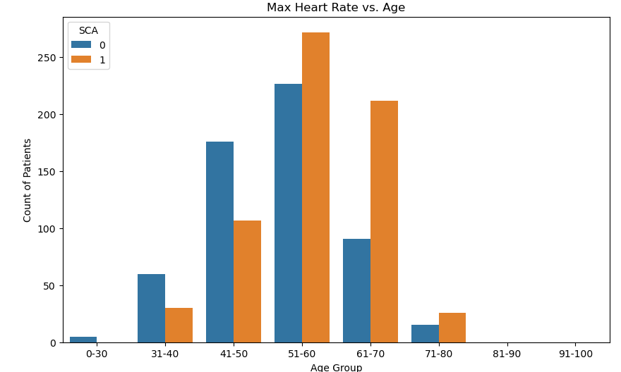
FINDINGS
The plot reveals that older patients who suffer from Sudden Cardiac Arrest (SCA) generally exhibit a higher heart rate compared to patients who are up to the age of 50.

Slide 11
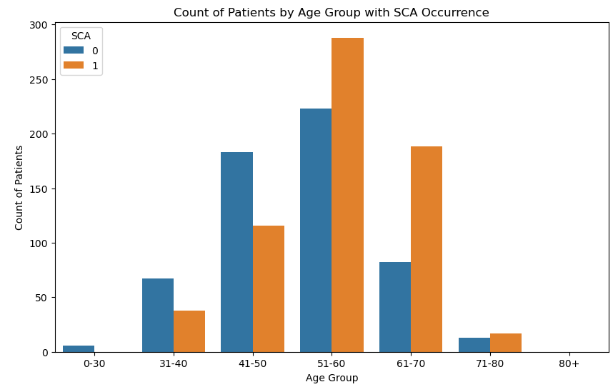
FINDINGS
Age appears to be a significant factor in predicting Sudden Cardiac Arrest (SCA), with the data indicating a higher prevalence of SCA in older individuals, particularly those aged above 50, compared to the younger demographic between 1 and 50 years.

Slide 12
Summary
Summary indicates that age, heart rate, and cholesterol levels are key factors in predicting Sudden Cardiac Arrest (SCA). Older patients, particularly those above 50, show a higher risk of SCA. Men are more prone to SCA compared to women. In terms of heart rate, older SCA patients exhibit higher rates than those under 50. Cholesterol levels in SCA patients range broadly from 0 to 400. Additionally, blood pressure data, when visualized, also contributes to understanding the risk factors associated with SCA.

Slide 13
Proposed Solution
The proposed solution from these findings is to implement targeted healthcare strategies focusing on the identified risk factors. This could include enhanced monitoring and preventive care for older patients, especially those above 50, and particular attention to men who are at higher risk of SCA. Heart rate and cholesterol levels should be closely monitored as part of routine check-ups. These measures, combined with education about the risks and symptoms of SCA, could significantly aid in early detection and prevention, thereby improving patient outcomes.

Slide 14
THANK YOU

